Slide 1
Pion Decay Example
Eric Prebys
Phy 40
Fall 2025

Slide 2
Relativity and Units
Remember forever!
Basic Relativity
Units
    Energy: eV (keV, MeV, etc) [1 eV = 1.6x10⁻¹⁹ J]
    Mass: eV/c² [proton = 1.67x10⁻²⁷ kg = 938 MeV/c²]
    Momentum: eV/c [proton @ β=.9 = 1.94 GeV/c]
Some Handy Relationships
These units make these relationships really easy to calculate

Slide 3
Kinetic Energy
A body in motion will have a
total energy given by
The difference between this
and mc² is called the “kinetic
energy”
Here are some examples of
kinetic energy
For v<<c (speed of light),
Kinetic energy ~ ½mv²
Kinetic Energy
Rest Energy
10

Slide 4
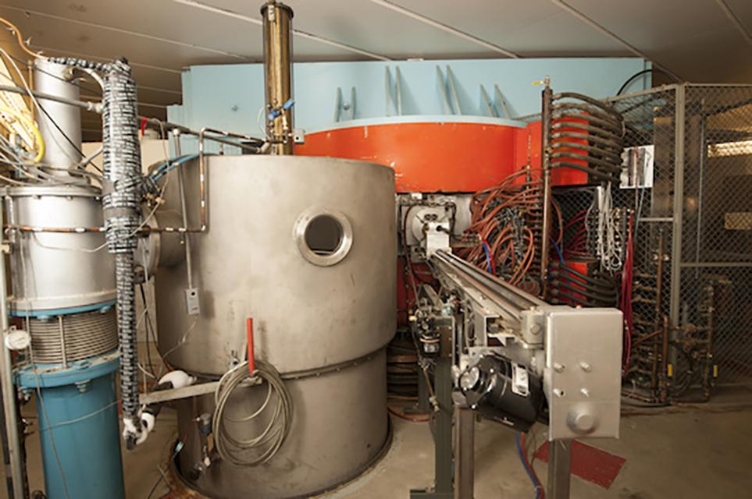
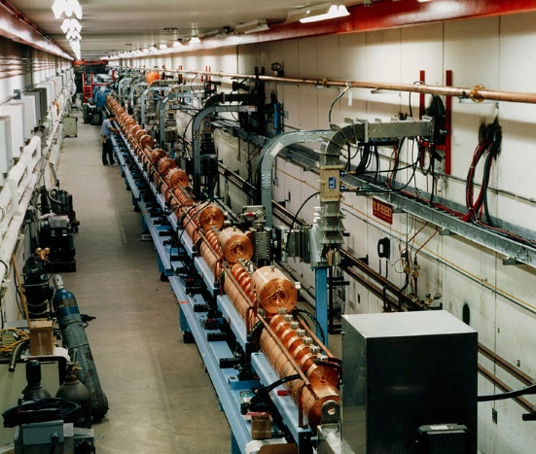
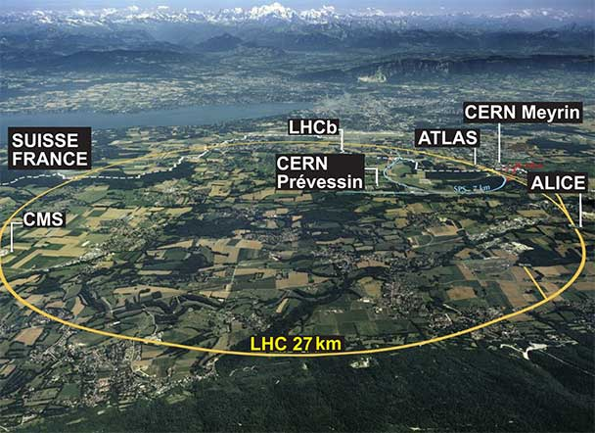
Example Beam Parameters
Crocker Nuclear Lab (across the path)
67 MeV protons
Fermilab LINAC
400 MeV protons
LHC at CERN
7 TeV
Parameter | Symbol | Equation | CNL | LINAC | LHC
Mass | m [GeV/c²] |  | 0.938
kinetic energy | K [GeV] |  | 0.067 | 0.400 | 7000
total energy | E [GeV] |  | 1.005 | 1.3382 | 7000.938
momentum | p [GeV/c] |  | .3608 | 0.95426 | 7000.938
rel. beta | β |  | .359 | 0.713 | 0.999999991
rel. gamma | γ |  | 1.071 | 1.426 | 7461.5
Note: the factors of “c” always cancel out!

Slide 5
4-Vectors and Lorentz Transformations
Usual conventions
Note that for a system of particles

Slide 6
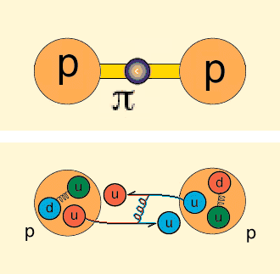
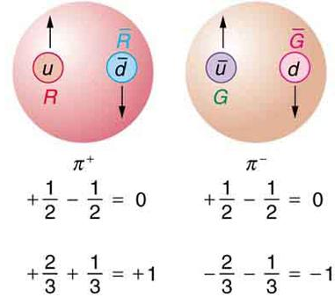
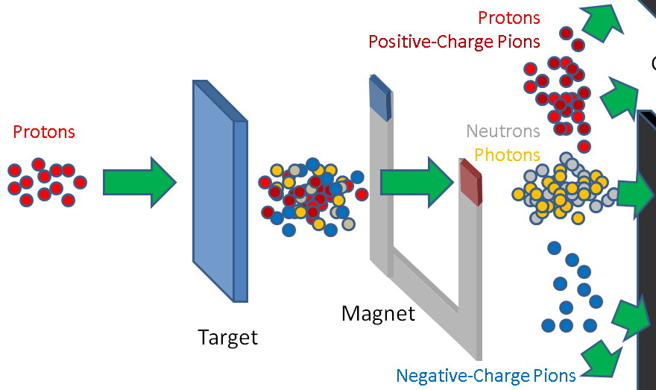
Charged Pions
Pions can be thought of as mediating the strong
force that hold nuclei together.
A π⁺ consists of an up quark and an anti-down
quark while a down π⁻ consists of an anti-up
quark and a down quark.
When a high energy proton beam hits a target, it
creates mostly pions.
  We can make a beam out of the pions
  We can also use their decay products
  muons and neutrinos.

Slide 7
Our Example Problem
We’re going to start with a charged pion beam with 1 GeV of kinetic energy.
200 downstream of the source will be a tracking detector 6m on a side.
  There will also be a 5cm diameter hole so the pions that haven’t decayed can pass through
Our goal is to calculate the fraction of the pions that will produce a decay muon that hits the tracking chamber.
μ⁺
1 GeV π⁺ beam
z
ν_{μ} (invisible)

Slide 8
Steps of the Problem
Generate a beam of beam of 1 GeV pions, moving in the z-direction
Calculate the decay position based on the lifetime, corrected for Lorentz time dilation.
Isotropically decay each pion to a muon and neutrino in its own rest frame.
Project the muon to the detector location.
  The neutrino will be invisible.
Determine whether the decay muons
  Hit the tracker
  Miss the tracker
  Go down the hole.

Slide 9
Vector Package
The vector package is a powerful set of routines to deal with 2D, 3D, and Lorenitz 4-vectors.
Can work in Cartesian, cylindrical, or polar coordinates.
Includes standard geometric operations
For 4-vectors, includes Lorentz boosting methods.
There is a ”particle” class in Scikit-HEP, which is better suited to more complicated operations, but vector will be find for this example.

Slide 10
Decay Parameters
The lifetime will be extended by time dilation by
The length it will travel will be
In the center of mass frame, the particles will go out back to back with equal momentum
The momentum is given by
Flat in cosθ and φ
(go to notebook)

Slide 11
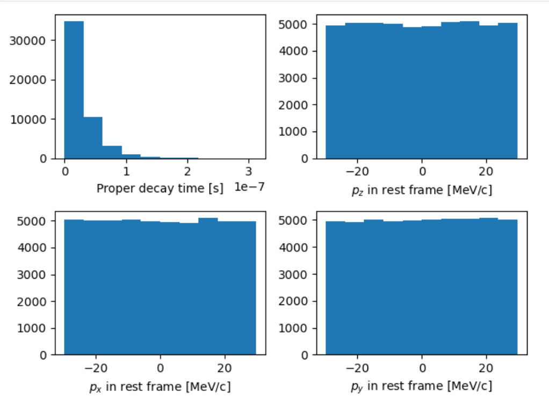
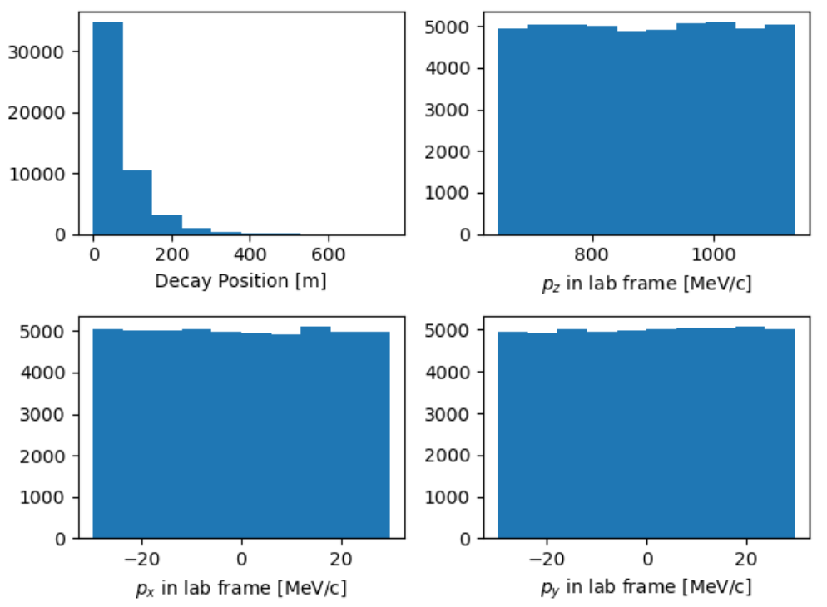
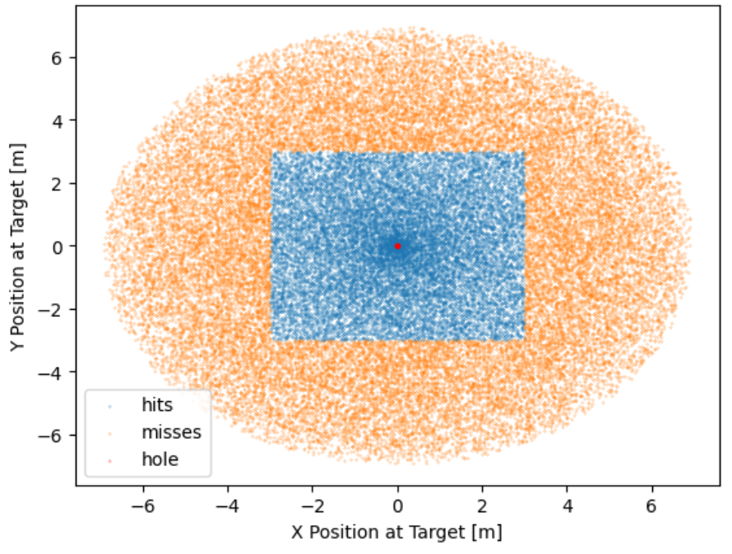
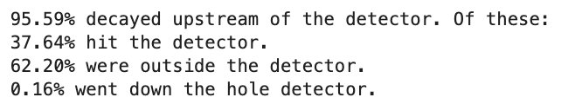
Results

